Slide 1
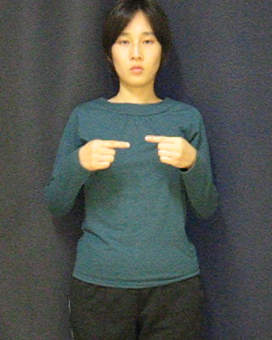
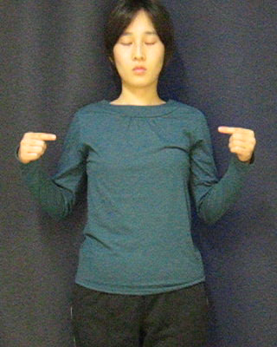
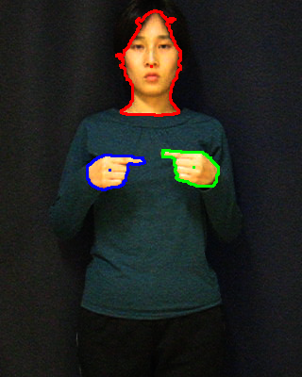
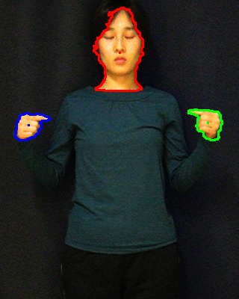
Construction of General HMMs from a Few Hand Motions for Sign Language Word Recognition
Tadashi Matsuo, Yoshiaki Shirai, Nobutaka Shimada
Ritsumeikan University/Department of Human and Computer Intelligence, Shiga, Japan
1. Recognition with HMM
Calculate likelihood
Extract feature
Model for word 1
Take the model with the largest likelihood
Raise
Right hand
Lower
Right hand
Stop
Model for word 2
Raise
Both hands
Spread
hands
Stop
Lower
hands
Recognition
Result
Input Images
Numeric features
Model for word 3
2. What is a problem?
Motions for the same word may differ in hand shape, speed, track, etc.
The topology of HMM should reflect the acceptable variation of the word.
Stop
Raise
right
Stop
Lower
right
Stop
Stop
Raise
right
Stop
Lower
right
Stop
We generate many candidate HMMs and evaluate them.
S₁
S₂
S₃
S₄
S₅
S₁
S₂
S₃
S₄
S₅
Stop
Raise right
Lower right
Stop
Stop
Raise right
Lower right
Stop
How to select a HMM without over-fitting training samples?
3. Virtual samples
The HMM with highest likelihood for training samples
Few training samples
An input motion acceptable but different from training samples
They may cause a over-fitting HMM.
Low likelihood
Various training samples
They are desirable, but require high cost.
High likelihood
With virtual samples
Real samples
Virtual samples
generative model
High likelihood
Over-fitting can be avoided without high cost.

Slide 2
4. How to generate virtual samples
Groups of segmented real samples^{[1]}
HMM for generating virtual samples
Virtual samples
Stop
Raise
right
Lower
right
Stop
Use the HMM as a generative model.
Stop
Raise
right
Stop
Lower
right
Stop
Stop
Raise
right
Stop
Lower
right
Stop
Stop
Raise
right
Rotate
right
Lower
right
Each virtual sample is a variation of one of the groups.
5. Total system
HMM for generating virtual samples
Real samples
Candidate HMMs
Virtual samples
They are generated by integration of motion segments[1].
Select the HMM with the highest likelihood
Generate virtual samples
6. Experiment
20 words, 3 person, 3 motions for a person and a word
7. Conclusion
Tab.1 Recognition accuracy for a speaker not used when training HMMs
Virtual samples improve HMM selection.
Rank | Left-to-right only | ML selection with n virtual samples
 |  | 0 | 1 | 6 | 12 | 24
1st | 0.394 | 0.444 | 0.476 | 0.490 | 0.487 | 0.478
2nd or above | 0.661 | 0.706 | 0.719 | 0.741 | 0.739 | 0.736
3rd orabove | 0.800 | 0.844 | 0.872 | 0.864 | 0.861 | 0.856
Over-fitting can be avoided without collecting high cost real samples.
Tab.2 Recognition accuracy for leave one out method
Rank | Left-to-right only | ML selection with n virtual samples
 |  | 0 | 1 | 8 | 16 | 32
1st | 0.706 | 0.733 | 0.743 | 0.752 | 0.749 | 0.748
2nd or above | 0.872 | 0.922 | 0.920 | 0.923 | 0.926 | 0.921
3rd or above | 0.950 | 0.972 | 0.963 | 0.967 | 0.966 | 0.966
[1]T. Matsuo, Y. Shirai, N. Shimada, "Automatic Generation of HMM Topology for Sign Language Recognition”, The 19th International Conference on PATTERN RECOGNITION (ICPR2008), (2008).

